Slide 1

What’s the deal with React.js?
Vasanth Krishnamoorthy

Slide 2
We’ve got a problem…

Slide 3
Hacky solution
Idea
Re-render the page on any change.
Pros
Data flow and UI is simple to understand (like 90s)
Cons
Performance hit: Rendering all the elements is a bad idea. Culprit: DOM

Slide 4
A better solution? Cheat
How can we not touch the DOM often, but still know which parts of the UI should change?
Solution:
Have a memory representation of the DOM and make changes there.
Virtual DOM

Slide 5
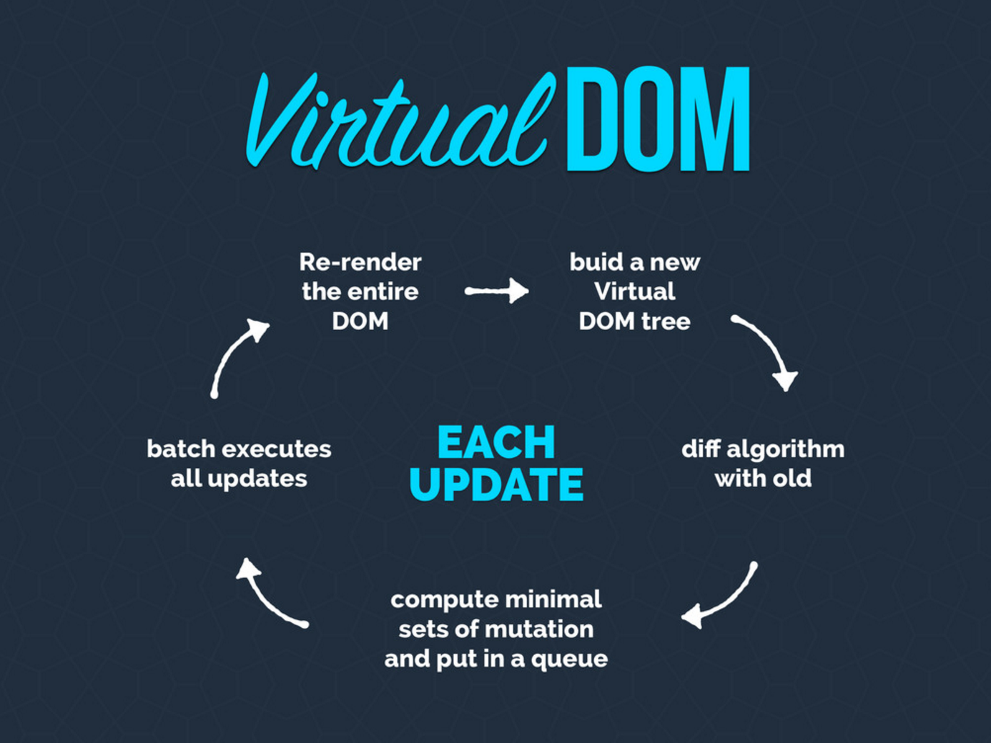

Slide 6
Virtual DOM benefits
Fast: All changes are done on the Virtual DOM
Less Janky: React batches changes/updates to the DOM in a sequence leading to lesser reflows/re-calculations.
Security: Eliminates XSS vulnerabilities.
Server Render: Can run on Node.js with no browser
Notes:
React basically makes it so you can't insert markup unless you create the elements yourself in the render function.
http://stackoverflow.com/a/33644981/1672655

Slide 7
Traditional UIs
Programs tend to be composed of objects that talk to each other in different manners, all with their own state.
This often leads to bugs, with the state somewhere in the app getting in an unexpected state, breaking things.
This is the way we've programmed for years, which is the reason why "have you tried turning it off and on again" is an advice that works so well for devices that use any kind of software.

Slide 8
React
Your app state is mostly constrained to a single place, and your app is instead made up of stateless functions that react to the state changing, and pipe their results to React, which re-renders it.
This execution flow is generally much easier to reason about because side-effects doesn't happen all over the place.

Slide 9
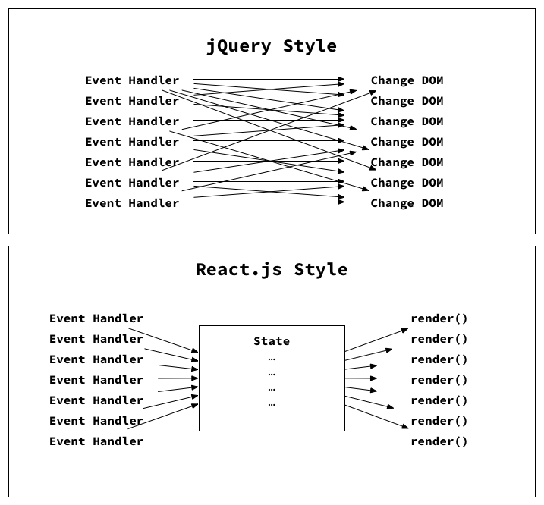
Imperative vs Declarative UIs

Slide 10
Component driven development
React favors composition
UI = Composition(components)
The idea is to follow the single responsibility principle and ideally, design your components to be responsible for only one thing.

Slide 11
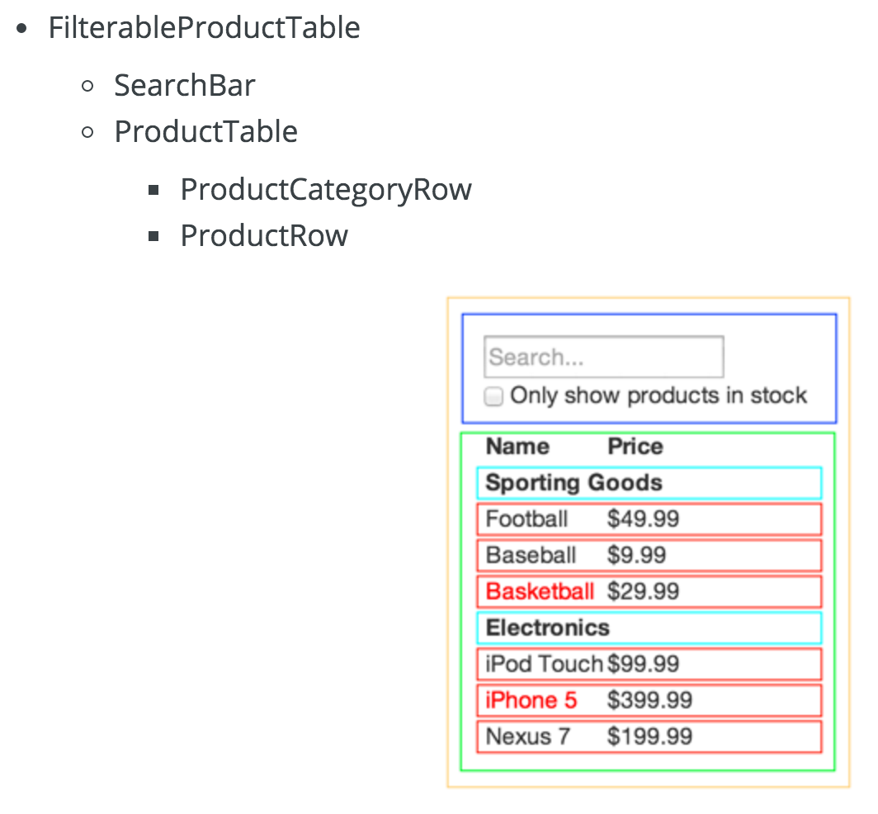
Thinking in React
Demo

Slide 12
When to use React?
“Any app with state that changes a lot will benefit from React”
Eg. Chat Apps, Facebook (obviously), Dynamic UIs (Netflix), Reusable shared UIs (Walmart/Sams club etc), Interactive Forms etc.

Slide 13
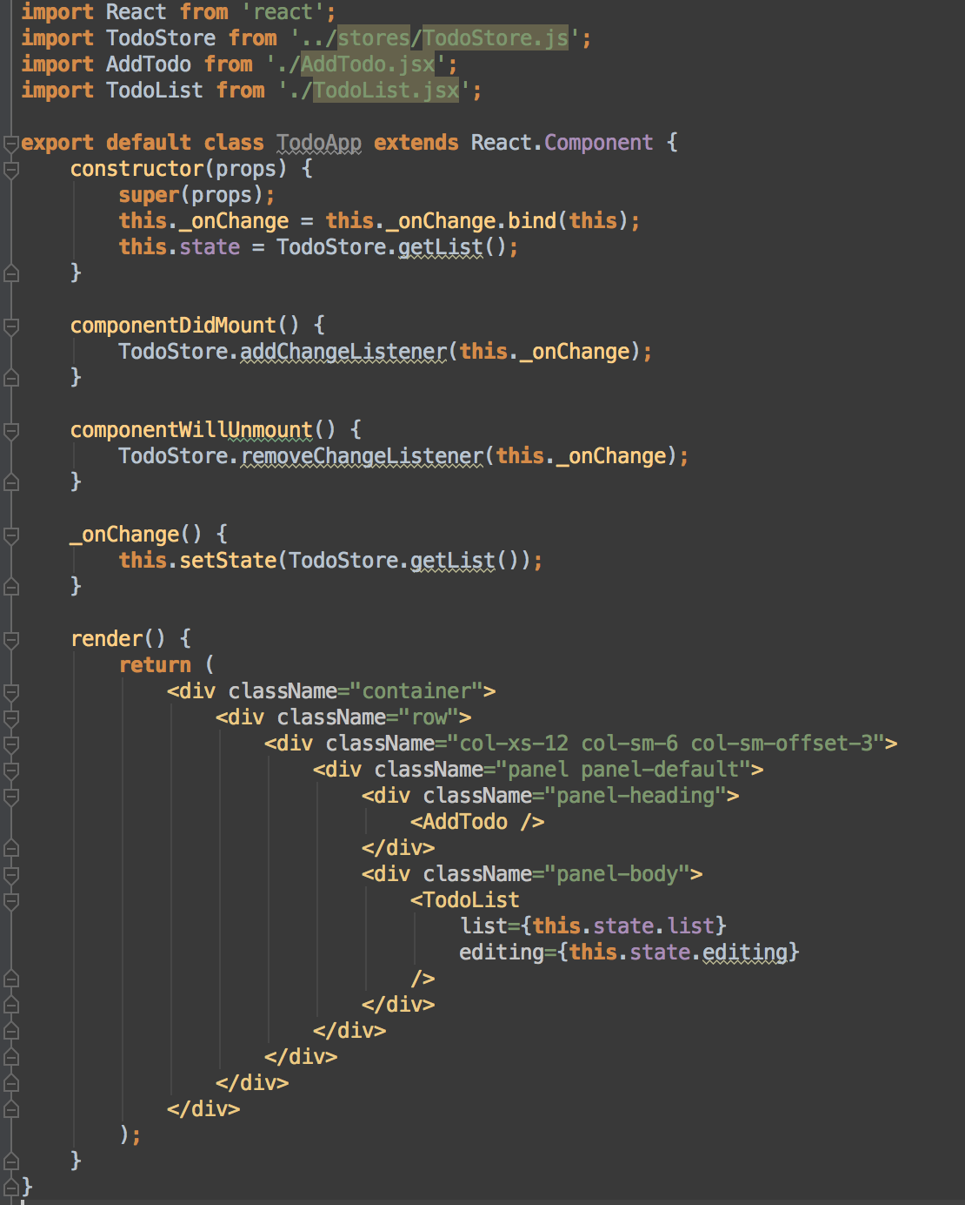
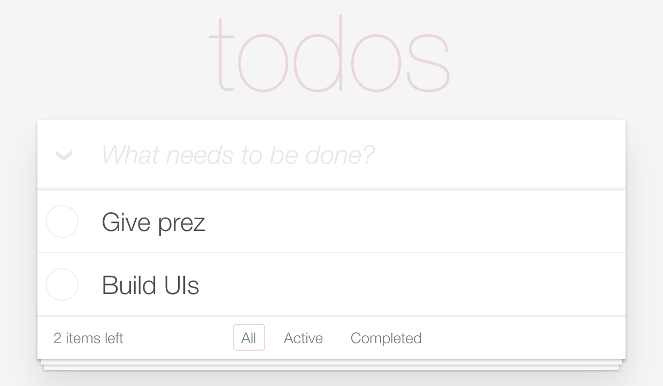
React Example

Slide 14
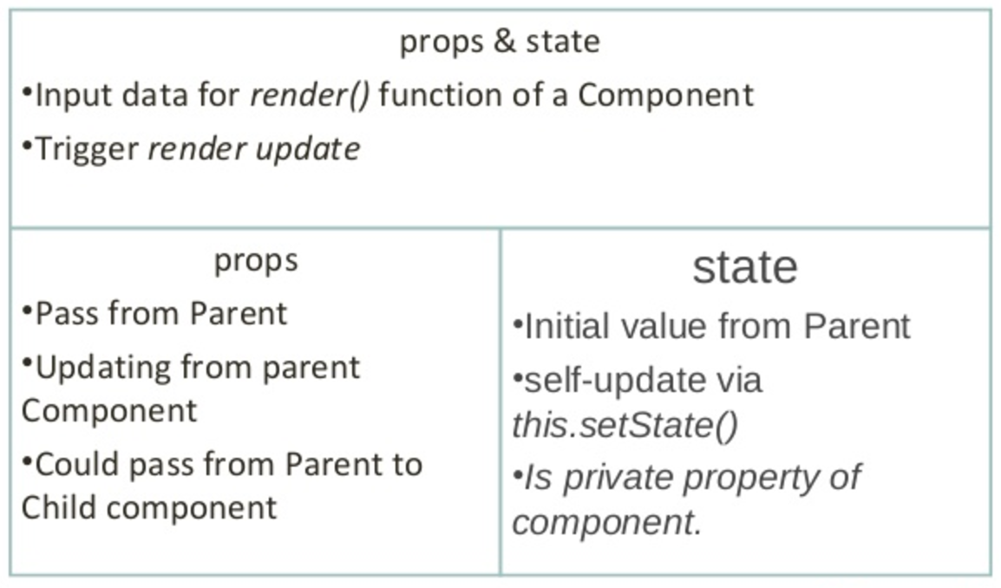
Props and State
Notes:
Props and state are somewhat related in the sense that they both “model” data for React components. Both of them can be passed down from parent to child components. However, the props and state of a parent component will become just props to their child component.

Slide 15
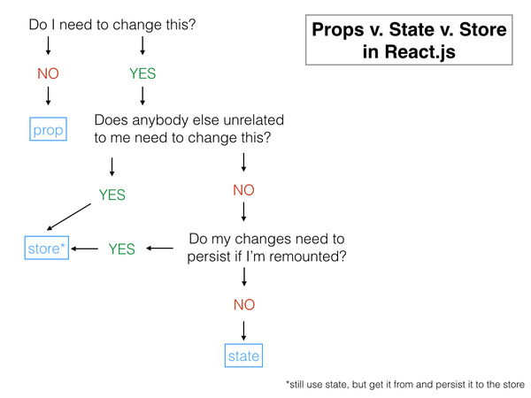
Props or state?

Slide 16
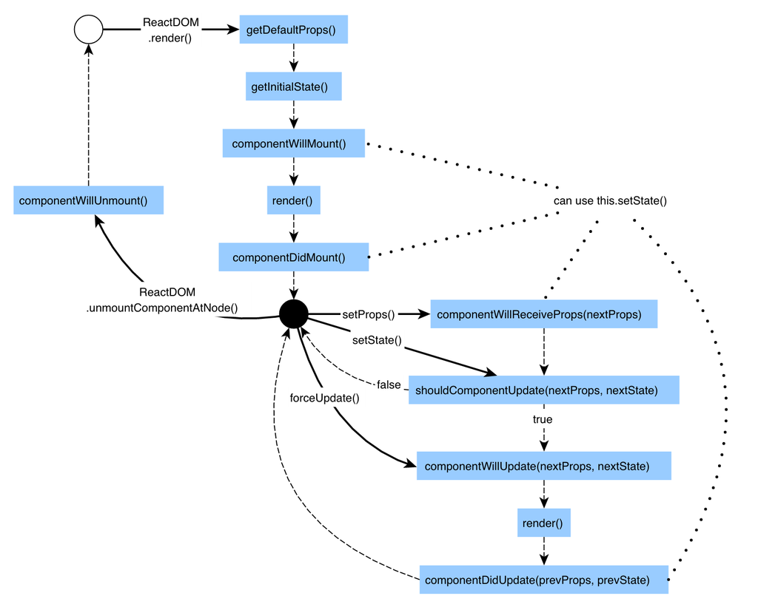
React Lifecycle

Slide 17
Best Practice Smart vs Dumb components
Smart Components
Describe how things work
Provide no DOM markup or styles
Provide app data, do data fetching
Call Flux/Redux actions
Named *Container by convention
Dumb Components
Describe how things look
Have no app dependencies
Receive only props, providing data and callbacks
Rarely have own state, when they do, it’s just UI state
Named anything that’s a UI noun
Notes:
https://css-tricks.com/learning-react-container-components/
http://jaketrent.com/post/smart-dumb-components-react/
https://medium.com/@dan_abramov/smart-and-dumb-components-7ca2f9a7c7d0#.jlfel472i

Slide 18
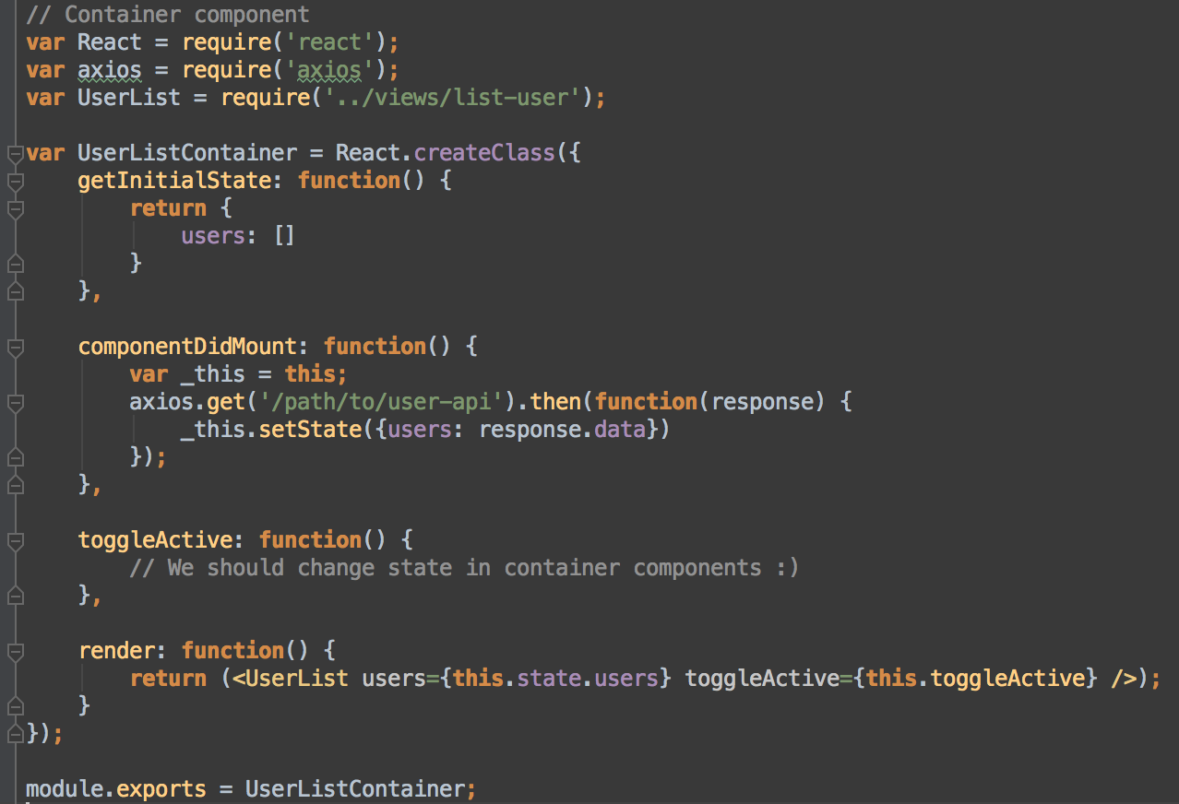
Smart Component
Notes:
In short, Container Components source the data and deal with state. State is then passed to Presentational Components as props and is then rendered into views.

Slide 19
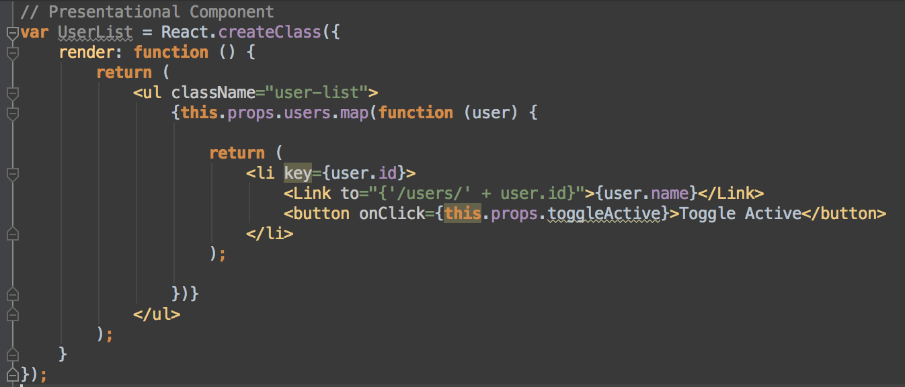
Dumb Component

Slide 20
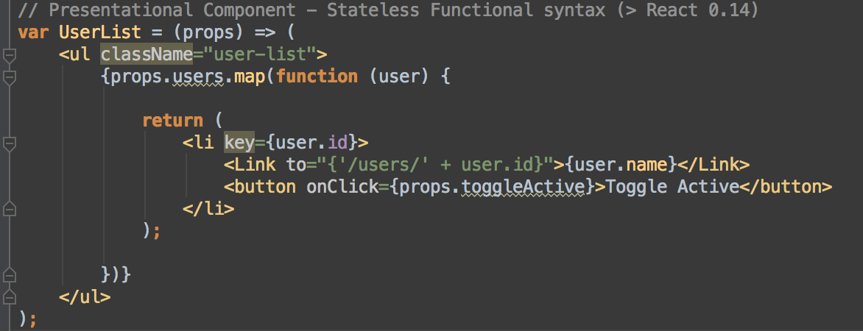
Dumb Component (Stateless function)

Slide 21
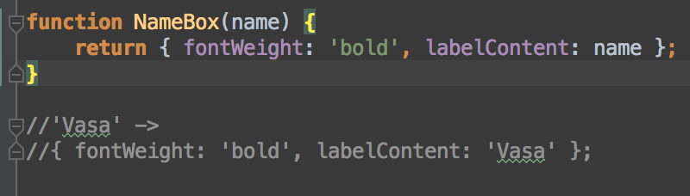
Principle 1: Transformation
UIs are simply a projection of data into a different form of data. The same input gives the same output. A simple pure function.

Slide 22
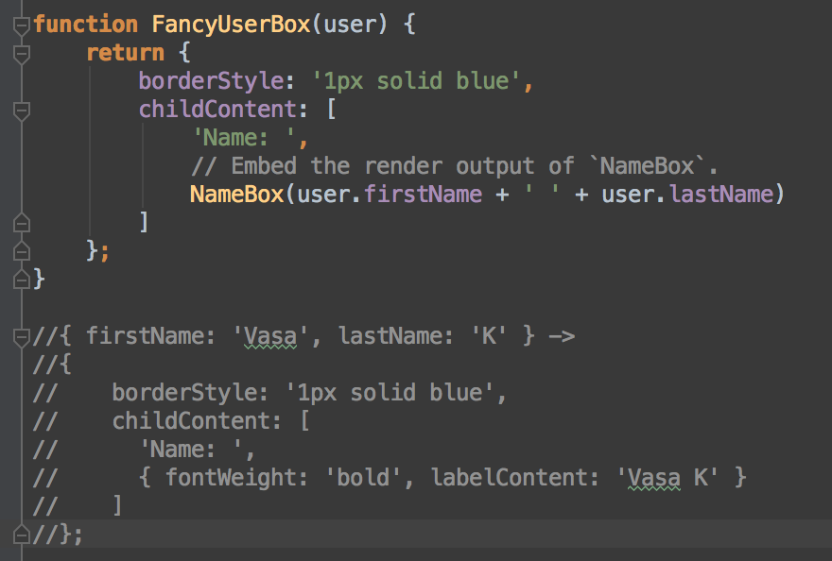
Principle 2: Abstraction
You can't fit a complex UI in a single function though. It is important that UIs can be abstracted into reusable pieces that don't leak their implementation details. Such as calling one function from another.

Slide 23
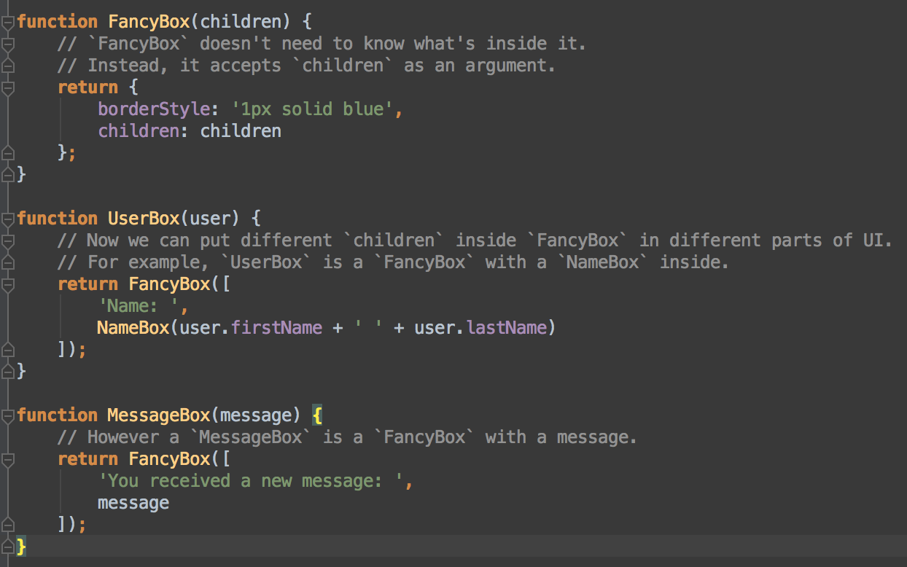
Principle 3: Composition
The ability to combine multiple abstractions into a new one.

Slide 24
Final thoughts
React is just the V in the MVC – So it is easy to plug it in to existing apps and test it out.
React introduces a bunch of functional programming principles into mainstream JS and this changes the way we think about front end code abstractions.
Philosophy: “Learn once, write anywhere.”
React Native enables us to share our views between Web/Android/iOS versions of the App
- This is a boon for us JS developers to build cross platform apps - Might as well be the future ☺

Slide 25
Thank you
Any Questions??

